Slide 1
Sorting and Searching – Divide and Conquer Approach

Slide 2
Instructor
Dr. Ab Rouf Khan
Assistant Professor
VIT Bhopal University

Slide 3
Outline [Module 2 (Part 2)]
Divide and Conquer (DAC) Approach: General Method.
Master’s Method to solve the recurrence relations
Sorting
Merge Sort
Quick Sort
Searching
Binary Search

Slide 4
Divide and Conquer (Recap)
Divide the problem into a number of sub-problems
Similar sub-problems of smaller size
Conquer the sub-problems
Solve the sub-problems recursively
Sub-problem size small enough ⇒ solve the problems in straightforward manner
Combine the solutions of the sub-problems
Obtain the solution for the original problem

Slide 5
Master’s Method (Master Theorem)
Let T(n) be a monotonically increasing function that satisfies
T(n) = a T(n/b) + f(n)
T(1) = c
where a ≥ 1, b ≥ 2, c>0.
If f(n) is Θ(n^{d}) where d ≥ 0 then
 |  | if a < b^{d}
T(n) = |  | If a = b^{d}
 |  | if a > b^{d}

Slide 6
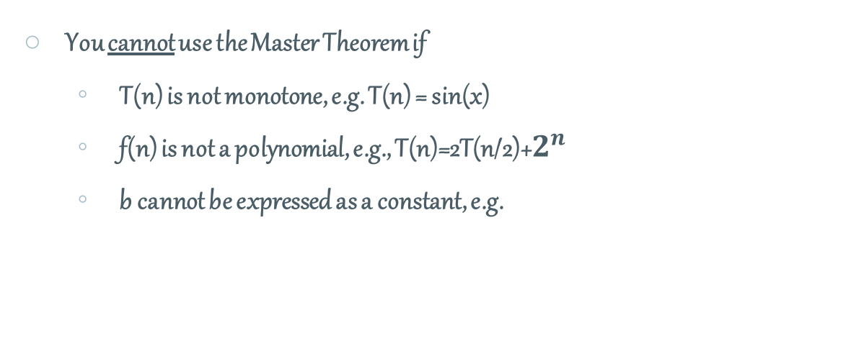
Master’s Method: Pitfalls
You cannot use the Master Theorem if
T(n) is not monotone, e.g. T(n) = sin(x)
f(n) is not a polynomial, e.g., T(n)=2T(n/2)+$2^{n}$
b cannot be expressed as a constant, e.g.

Slide 7
Master Theorem
3 Cases!
Case – 1
Case – 2
Case – 3

Slide 8
Master’s Method: Case 1
Compare a with b^{d}:
If a > b^{d},
log_{b}a > d
n^{logba} > n^{d}
We also know that f(n) ∈ Θ(n^{d})
f (n) grows polynomially slower than n^{logba}.
Solution: T(n) = Θ(n^{logba}) .

Slide 9
Master’s Method: Case 2
Compare a with b^{d}:
If a = b^{d},
log_{b}a = d
N^{logba} = n^{d}
We also know that f(n) ∈ Θ(n^{d})
f (n) and n^{logba} grow at similar rates.
Solution: T(n) = Θ( f(n) log n) .

Slide 10
Master’s Method: Case 3
Compare a with b^{d}:
If a < b^{d},
log_{b}a < d
n^{logba} < n^{d}
We also know that f(n) ∈ Θ(n^{d})
f (n) grows polynomially faster than n^{logba}.
Solution: T(n) = Θ( f (n) ) = Θ(n^{d}).

Slide 11
Master’s Method: Examples – I
Ex. 1. T(n) = 4T(n/2) + n
a = 4, b = 2, d = 1 ⇒ n^{logba} = n²; f (n) = n.
(a=4) >( b^{d} =2¹)
CASE 1: ∴ T(n) = Θ(n²).
Ex. 2. T(n) = 4T(n/2) + n²
a = 4, b = 2, d=2 ⇒ n^{logba} = n²; f (n) = n².
(a =4) = (b^{d}=2²)
CASE 2: ∴ T(n) = Θ(n²log n).

Slide 12
Master’s Method: Examples – II
Ex. 3. T(n) = 4T(n/2) + n³
a = 4, b = 2, d=3 ⇒ n^{logba} = n²; f (n) = n³.
(a=4) < (b^{d} = 2³)
CASE 3:
∴ T(n) = Θ(n^{d}) = Θ(n³).

Slide 13
Master’s Method: Homework

Slide 14
Quick Sort
Developed by C. A. R. Hoare – Mathematician
Fastest known sorting algorithm in practice
Average case: Lets Find!
Worst case: Lets Find!
Another divide-and-conquer recursive algorithm, like merge sort.
Pivot
Pivot
Pivot

Slide 15
Quick Sort – Idea
Quicksort uses a divide and conquer strategy, but does not require the O(N) extra space that MergeSort does
Partition array into left and right sub-arrays
Choose an element of the array, called pivot
the elements in left sub-array are all less than pivot
elements in right sub-array are all greater than pivot
Recursively sort left and right sub-arrays
Concatenate left and right sub-arrays in O(1) time

Slide 16
Quick Sort: Example – Four Easy Steps!
To sort an array S
1. If the number of elements in S is 0 or 1, then return. The array is sorted.
2. Pick an element v in S. This is the pivot value.
3. Partition S-{v} into two disjoint subsets, S₁ = {all values x≤v}, and S₂ = {all values x≥v}.
4. Return QuickSort(S₁), v, QuickSort(S₂)

Slide 17
Quick Sort – Four Easy Steps!
S
select pivot value
81
43
31
57
13
75
92
0
65
26
S₁
S₂
partition S
0
31
75
13
43
65
92
81
26
57
QuickSort(S₁) and
QuickSort(S₂)
S₁
S₂
0
13
26
31
43
57
65
75
81
92
S
0
13
26
31
43
57
65
75
81
92
Voila! S is sorted

Slide 18
Quick Sort – Design
Follows the divide-and-conquer paradigm.
Divide: Partition (separate) the array A[p..r] into two (possibly empty) subarrays A[p..q–1] and A[q+1..r].
Each element in A[p..q–1] < A[q].
A[q] < each element in A[q+1..r].
Index q is computed as part of the partitioning procedure.
Conquer: Sort the two subarrays by recursive calls to quicksort.
Combine: The subarrays are sorted in place – no work is needed to combine them.
How do the divide and combine steps of quicksort compare with those of merge sort?

Slide 19
Quick Sort – Pseudocode
Quicksort(A, p, r)
if p < r then
q = Partition(A, p, r);
Quicksort(A, p, q – 1);
Quicksort(A, q + 1, r)
Partition(A, p, r)
x, i = A[r], p – 1;
for j= p to r – 1 do
if A[j] ≤ x then
i= i + 1;
A[i] ↔ A[j]
A[i + 1] ↔ A[r];
return i + 1
A[p..r]
5
A[p..q – 1]
A[q+1..r]
Partition
5
≤ 5
≥ 5

Slide 20
Example
Quick Sort – Example
p r
initially: 2 5 8 3 9 4 1 7 10 6 note: pivot (x) = 6
i j
next iteration: 2 5 8 3 9 4 1 7 10 6
i j
next iteration: 2 5 8 3 9 4 1 7 10 6
i j
next iteration: 2 5 8 3 9 4 1 7 10 6
i j
next iteration: 2 5 3 8 9 4 1 7 10 6
i j
Partition(A, p, r)
x, i := A[r], p – 1;
for j := p to r – 1 do
if A[j] ≤ x then
i := i + 1;
A[i] ↔ A[j]
A[i + 1] ↔ A[r];
return i + 1

Slide 21
Quick Sort – Example (Continued …)
next iteration: 2 5 3 8 9 4 1 7 10 6
i j
next iteration: 2 5 3 8 9 4 1 7 10 6
i j
next iteration: 2 5 3 4 9 8 1 7 10 6
i j
next iteration: 2 5 3 4 1 8 9 7 10 6
i j
next iteration: 2 5 3 4 1 8 9 7 10 6
i j
next iteration: 2 5 3 4 1 8 9 7 10 6
i j
after final swap: 2 5 3 4 1 6 9 7 10 8
i j
Partition(A, p, r)
x, i := A[r], p – 1;
for j := p to r – 1 do
if A[j] ≤ x then
i := i + 1;
A[i] ↔ A[j]
A[i + 1] ↔ A[r];
return i + 1

Slide 22
Complexity of Partition Algorithm
PartitionTime(n) is given by the number of iterations in the for loop.
Θ(n) : n = r – p + 1.
Partition(A, p, r)
x, i := A[r], p – 1;
for j := p to r – 1 do
if A[j] ≤ x then
i := i + 1;
A[i] ↔ A[j]
A[i + 1] ↔ A[r];
return i + 1

Slide 23
Partitioning in Quick Sort
A key step in the Quicksort algorithm is partitioning the array
We choose some (any) number p in the array to use as a pivot
We partition the array into three parts:
p
numbers less than p
p
numbers greater than or equal to p

Slide 24
Analysis of Quick Sort – Best Case
Suppose each partition operation divides the array almost exactly in half
Then the depth of the recursion in log₂n
Because that’s how many times we can halve n
We note that
Each partition is linear over its subarray
All the partitions at one level cover the array

Slide 25
Partitioning at various levels

Slide 26
Quick Sort – Best Case Analysis
We cut the array size in half each time
So the depth of the recursion in log₂n
At each level of the recursion, all the partitions at that level do work that is linear in n
O(log₂n) * O(n) = O(n log₂n)
Hence in the best case, quicksort has time complexity O(n log₂n)
What about the worst case?

Slide 27
Quick Sort – Worst Case Analysis
In the worst case, partitioning always divides the size n array into these three parts:
A length one part, containing the pivot itself
A length zero part, and
A length n-1 part, containing everything else
We don’t recur on the zero-length part
Recurring on the length n-1 part requires (in the worst case) recurring to depth n-1

Slide 28
Worst Case Partitioning

Slide 29
Worst Case of Quick Sort
In the worst case, recursion may be n levels deep (for an array of size n)
But the partitioning work done at each level is still n
O(n) * O(n) = O(n²)
So worst case for Quicksort is O(n²)
When does this happen?
There are many arrangements that could make this happen
Here are two common cases:
When the array is already sorted
When the array is inversely sorted (sorted in the opposite order)

Slide 30
Typical Case of Quick Sort
If the array is sorted to begin with, Quicksort is terrible: O(n²)
It is possible to construct other bad cases
However, Quicksort is usually O(n log₂n)
The constants are so good that Quicksort is generally the faster algorithm.
Most real-world sorting is done by Quicksort

Slide 31
Quick Sort for Small Arrays
For very small arrays (N<= 20), quicksort does not perform as well as insertion sort
A good cutoff range is N=10
Switching to insertion sort for small arrays can save about 15% in the running time

Slide 32
Mergesort vs Quicksort
Both run in O(n lgn)
Mergesort – always.
Quicksort – on average
Compared with Quicksort, Mergesort has less number of comparisons but larger number of moving elements
In Java, an element comparison is expensive but moving elements is cheap. Therefore, Mergesort is used in the standard Java library for generic sorting

Slide 33
Mergesort vs Quicksort
In C++, copying objects can be expensive while comparing objects often is relatively cheap. Therefore, quicksort is the sorting routine commonly used in C++ libraries
Note these last two rules are not really language specific, but rather how the language is typically used.

Slide 34
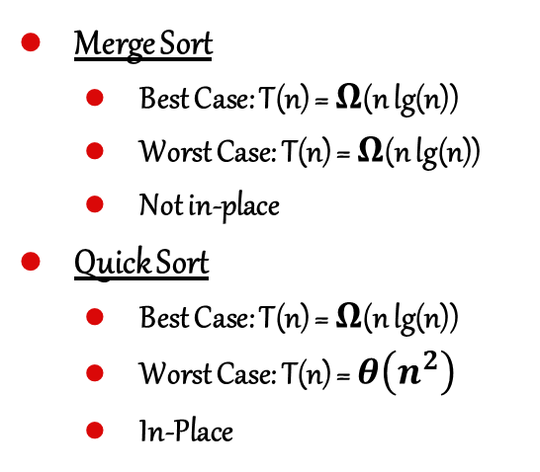
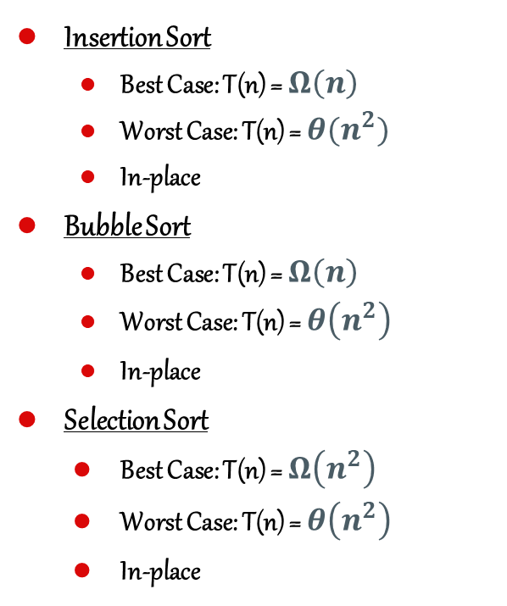
Comparison of Sorting Techniques
Insertion Sort
Best Case: T(n) = $Ω\left(n\right)$
Worst Case: T(n) = $θ(n^{2})$
In-place
Bubble Sort
Best Case: T(n) = $Ω\left(n\right)$
Worst Case: T(n) = $θ\left(n^{2}\right)$
In-place
Selection Sort
Best Case: T(n) = $Ω\left(n^{2}\right)$
Worst Case: T(n) = $θ\left(n^{2}\right)$
In-place
Merge Sort
Best Case: T(n) = $Ω$(n lg(n))
Worst Case: T(n) = $Ω$(n lg(n))
Not in-place
Quick Sort
Best Case: T(n) = $Ω$(n lg(n))
Worst Case: T(n) = $θ\left(n^{2}\right)$
In-Place

Slide 35

Recap

Slide 36
Thank You

